Slide 2

07
Lesson 07
Triangle Area and Area Method II

Slide 3
Part 1
Swallow Theorem

Slide 4
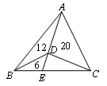
Example 1
(1) Area of each triangle is shown below. Find area of △ABC.

Slide 5
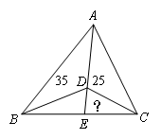
Example 1
(2) As is shown in figure below, area of △ABD is 35, area of △ACD is 25, area of △BCD is 24. Find area of △CDE.

Slide 6
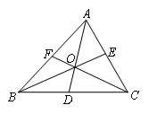
Example 2
(1) In △ABC, BD:DC=3:4, AE:CE=5:6. Find AF:FB.

Slide 7
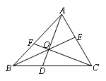
Example 2
(2) In △ABC, BD:DC=4:9, CE:EA=4:3. Find AF:FB.

Slide 8
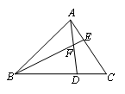
Example 3
(1) Area of △ABC is 1. BD=2DC, CE=2AE. AD and BE intersect at point F. Find area of △AEF, △BFD, △AFB, quadrilateral EFDC.

Slide 9
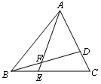
Example 3
(2) In △ABC, EC=2BE, AD=2DC. Area of △ABC is 42. Find area of △BEF.

Slide 10
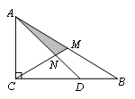
Example 4
In △ABC, ∠ACB=90°. AC=2, CD=2, CB=3, AM=BM. Find area of △AMN.

Slide 11
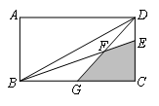
Example 5
(1) Area of rectangle ABCD is 2. EC=2DE. G is midpoint of BC. Find area of shaded region.

Slide 12
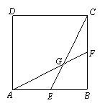
Example 5
(2) Side length of square ABCD is 12. E, F is midpoint of AB, BC, respectively. AF and CE intersect at point G. Find area of quadrilateral AGCD.

Slide 13
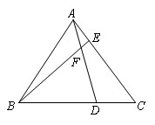
Example 6
Example 6
Area of △ABC is 72. FD=2AF, BD=4DC. Find area of quadrilateral DFEC.

Slide 14
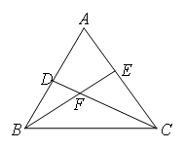
Example 7
In △ABC, D, E is point of the side of AB, AC, respectively. BE and CD intersect at point F. Area of △BDF is 10, area of △CEF is 16, area of △BCF is 20. Find area of △ABC.

Slide 15

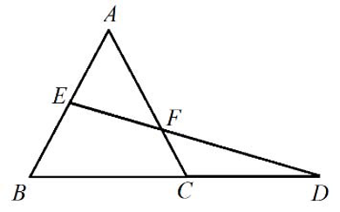
Example 8
ABC is an equilateral triangle with sides equal to 2cm. BC is extended its own length to D, and E is the midpoint of AB. ED meets AC at F. Find the area of the quadrilateral BEFC in square centimeters.

Slide 16
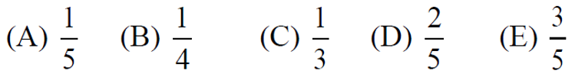
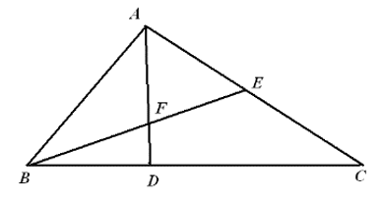
Example 9
In triangle ABC, AE=CE, and D is a point on side BC such that DC=2BD; AD and BE intersect at F. The ratio of the area of △AEF to the area of quadrilateral FDCE is

Slide 17
Part 2
AMC 10 Area Method Comprehensive

Slide 18
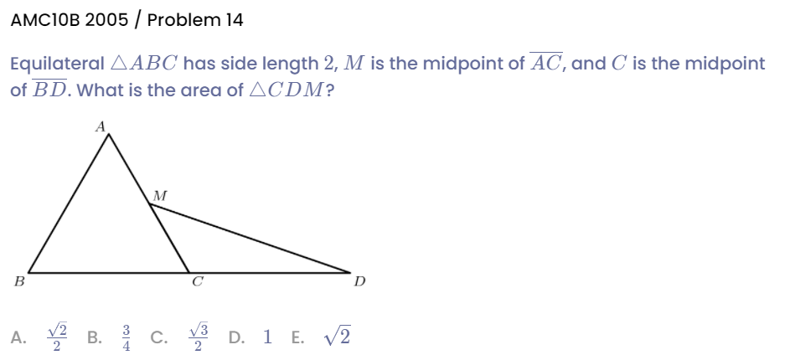
Example 1

Slide 19
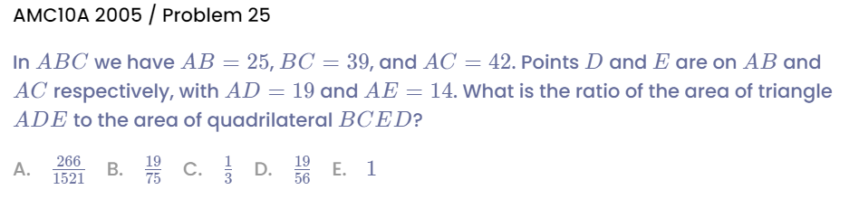
Example 2

Slide 20
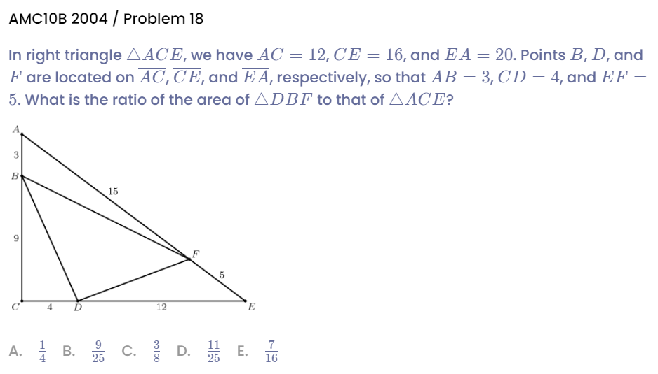
Example 3

Slide 21
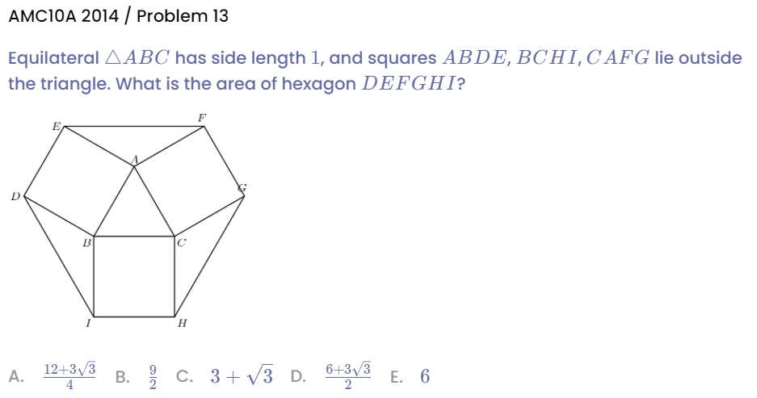
Example 4

Slide 22
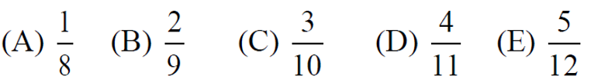
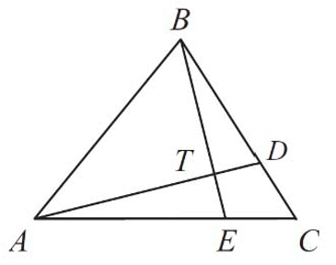
Example 5
(AMC 10) In △ABC points D and E lie on BC and AC, respectively. Suppose that AD and BE intersect at T so that AT/DT=3 and BT/ET=4. What is the value of CD/BD?

Slide 23
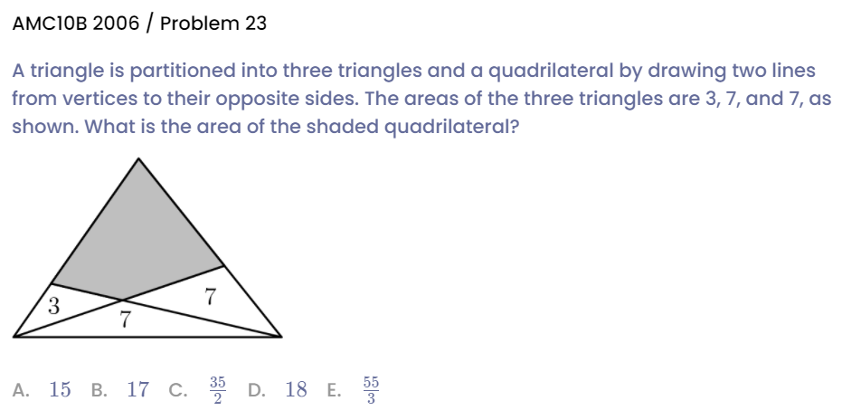
Example 6

Slide 24
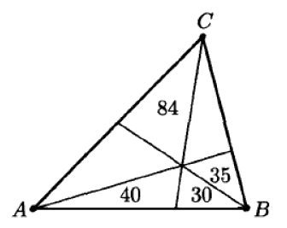
Example 7
(AIME) As shown in the figure on the right, △ABC is divided into six smaller triangles by lines drawn from the vertices through a common interior point. The areas of four of these triangles are indicated. Find the area of △ABC.

Slide 25
See You Next Time!

